Slide 1
Nifty 50 stock price prediction
Ashish Kumar pd15_058
Ayush Saxena pd15_033
Khan Nooman pd15_166
Ragavendran pd15_031
Samrudh Samarth pd15_320

Slide 2
AGENDA
Introduction
Primary Goal and Objectives
Tools
Important Codes
Future Scope
Challenges
Conclusion

Slide 3
INTRODUCTION
Nifty 50 index is an index in which the top 50 companies of India are listed.
The NIFTY 50 is a benchmark Indian stock market index that represents the weighted average of 50 of the largest Indian companies listed on the National Stock Exchange.
Nifty 50 is owned and managed by NSE Indices (previously known as India Index Services & Products Limited), which is a wholly-owned subsidiary of the NSE Strategic Investment Corporation Limited.
In this project we will predict the stock whether the stock is in profit or loss if we invest in the stock.

Slide 4
PRIMARY GOALS and Objectives
Our Primary goal is to find the best company stock we can pick, which will give the best return in the future.
For this we will make a model which takes input company purchase date, selling date, and the number of shares after we predict whether the number of shares, we bought is profitable or in a loss.

Slide 5
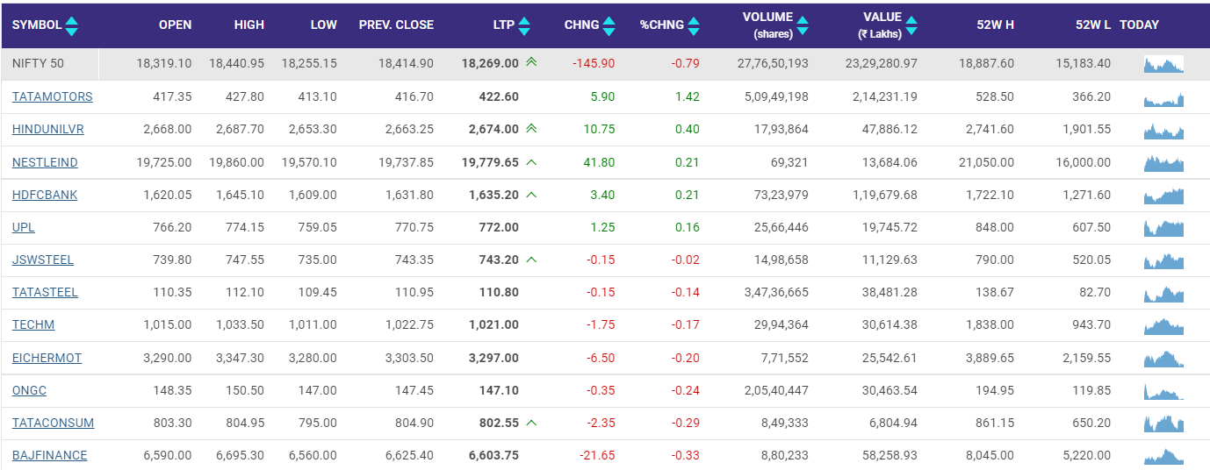
Nifty 50

Slide 6
Tools
Scraping:-
We have scraped the four-year data from the National Stock Exchange portal with the help nsepy library.
HTML :-
For Frontend part
Flask:- Micro Frame Work
For Backend Part

Slide 7
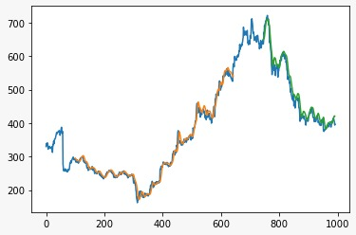
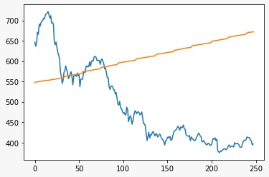
LSTM MODEL (LONG SHORT TERM MEMORY)
Long Short-Term Memory Networks is an advanced RNN, a sequential network, that allows information to persist. It is capable of handling the vanishing gradient problem faced by RNN. A recurrent neural network is also known as RNN is used for persistent memory.
Prediction With Regression Model

Slide 8
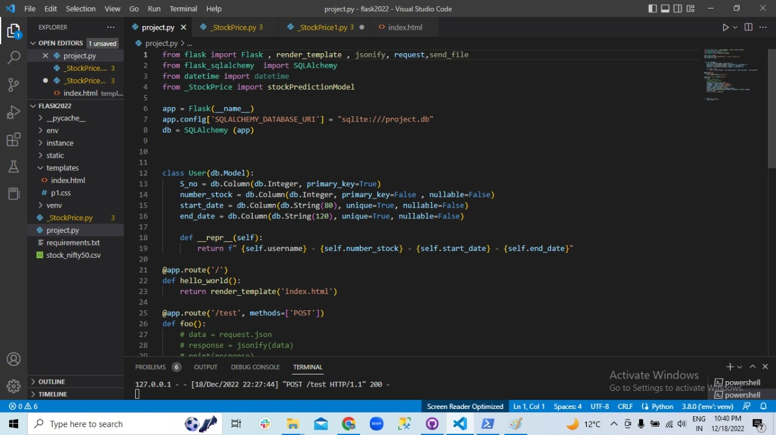
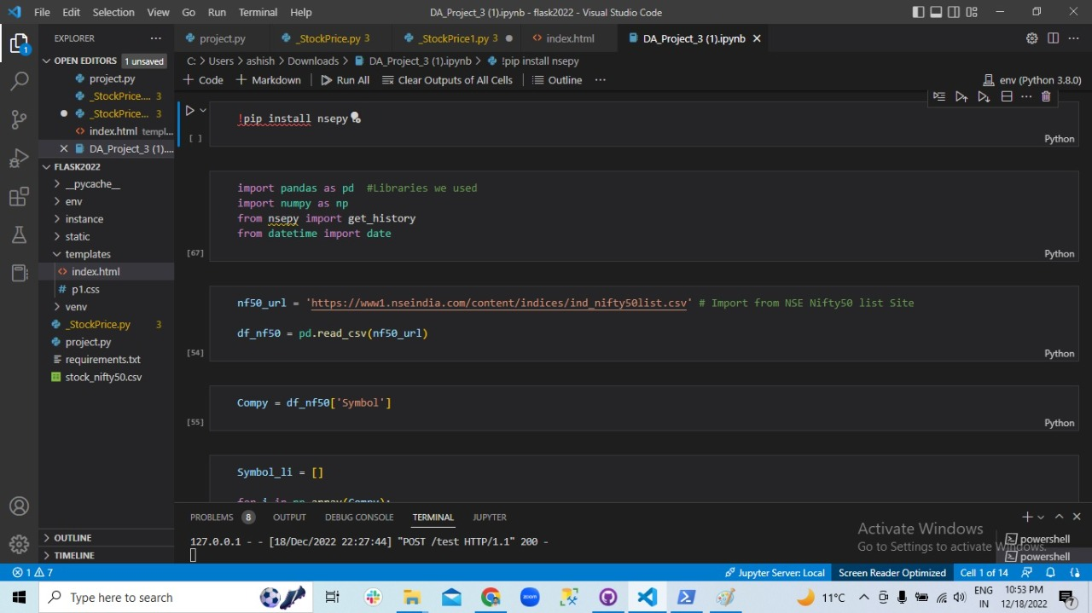
Flask Code
Web Scraped Code

Slide 9
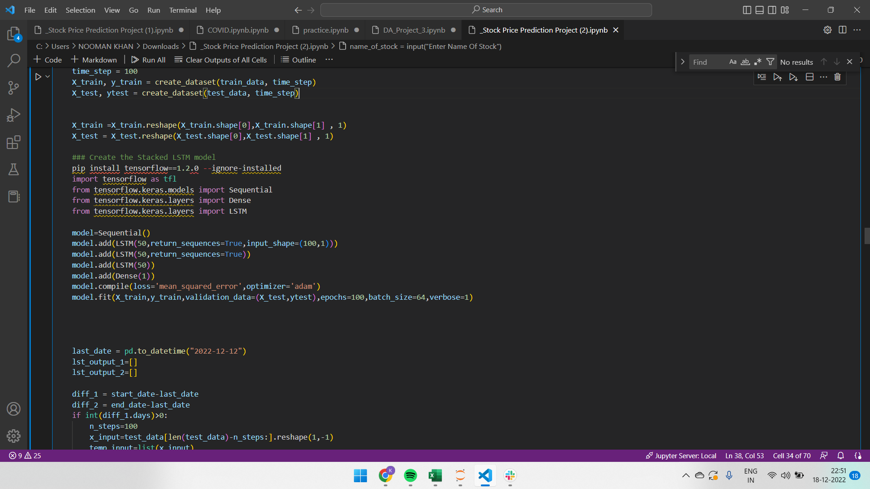
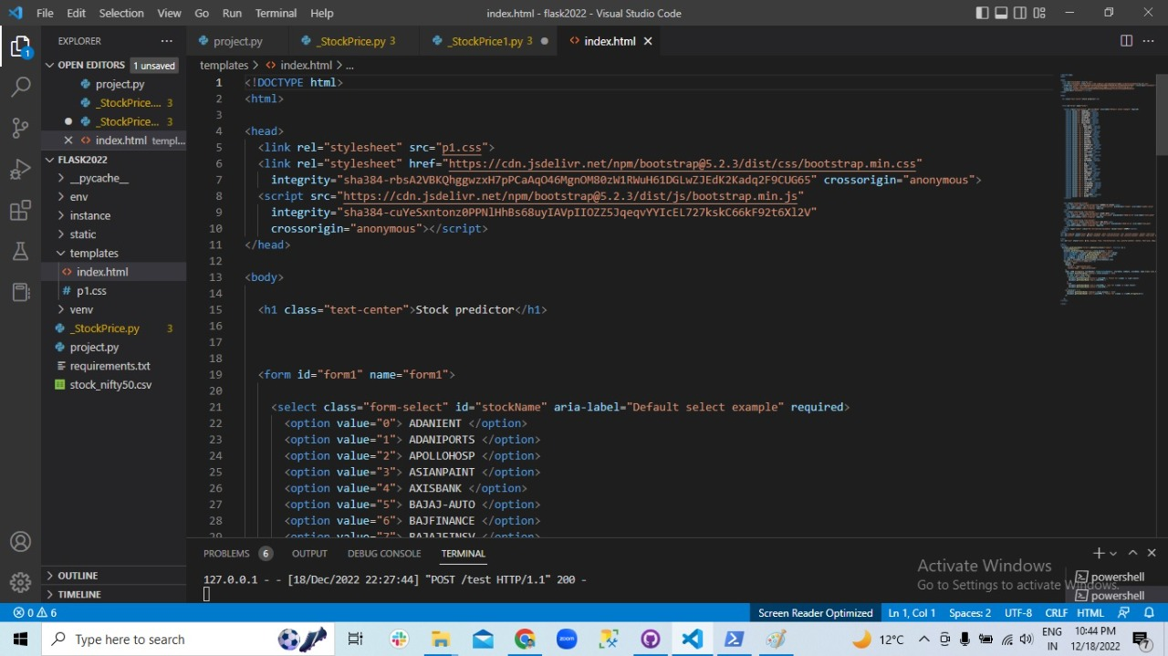
ML Code
HTML Code

Slide 10
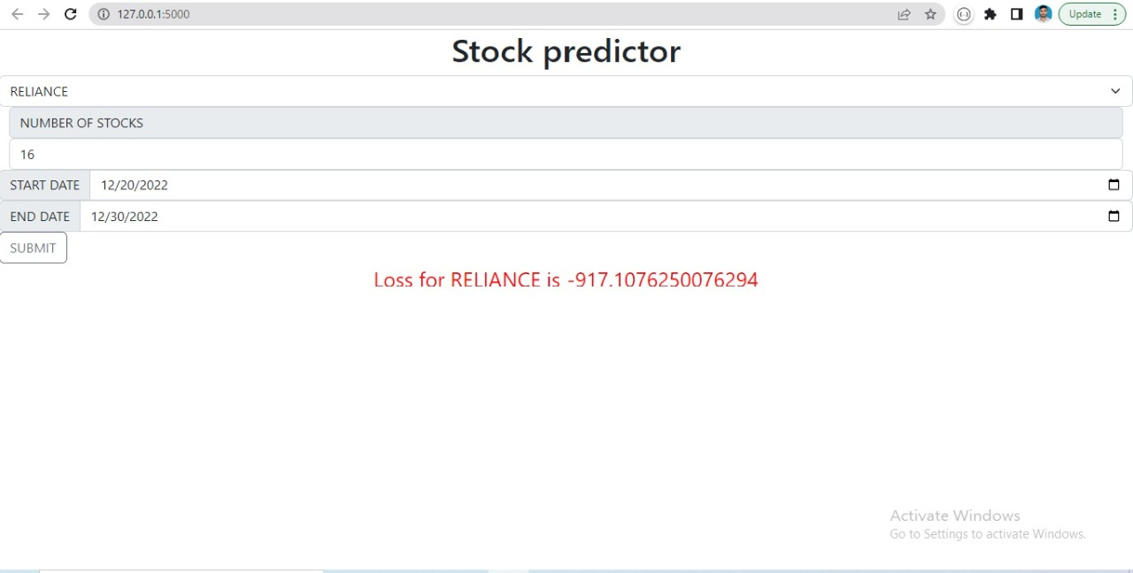
Landing page of STOCK PREDICTOR

Slide 11
FUTURE SCOPE
We can add the graph between purchase date and selling date so that it can easily visualize the future prediction.
Whenever the heavy fluctuation occur in the stock price it automatically sends the alert notification to the investor.

Slide 12
Challenges
All the concepts that we have used to complete the projects are new for our team for eg :- Scraping the data from nse website and flask ,Html.
These are some concepts that we learn in a short duration and implement it on our projects all have done their best effort to complete this project.

Slide 13
PLAN FOR project LAUNCH
All completion of our work its time to submit the project to our guide.
PLANNING
Plan to make a model of nifty 50 which help us to predict the loss or profit in future.
Discussion
All our team members discuss the project.
Distribution
All the team members distributed their work according to their expertise.
All the team members sit together and discuss all aspects of projects and put it in a presentation.
Submission
Presentation

Slide 14
Nifty 50 are the OPPORTUNITIES ARE LIKE BUSES. THERE'S ALWAYS ANOTHER ONE COMING.​
Team Members

Slide 15
Conclusion
After scraping the data ​from the National stock exchange, we created the model and then we used the flask to make API and HTML for frontend part and host our model on local server after that we can easily predict the future of stock

Slide 16




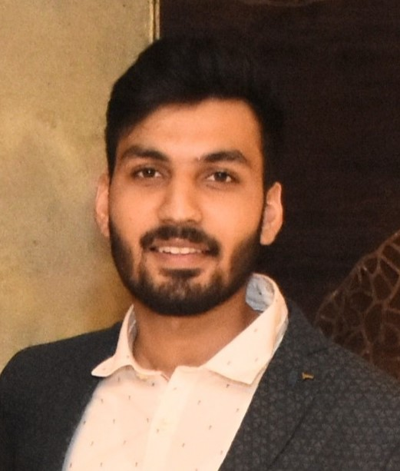
MEET OUR TEAM
Ashish Kumar
Ayush Saxena
Khan Nooman
Raghvendran
Samrudh Samarth
Pd15_058
Pd15_033
Pd15_166
Pd15_031
Pd15_320

Slide 17
THANK YOU
Github link :-
https://github.com/Ashishkumar00110/nifty_50_stock_predictor.git

